Slide 1
Trisomy 21
Anni 240321

Slide 2
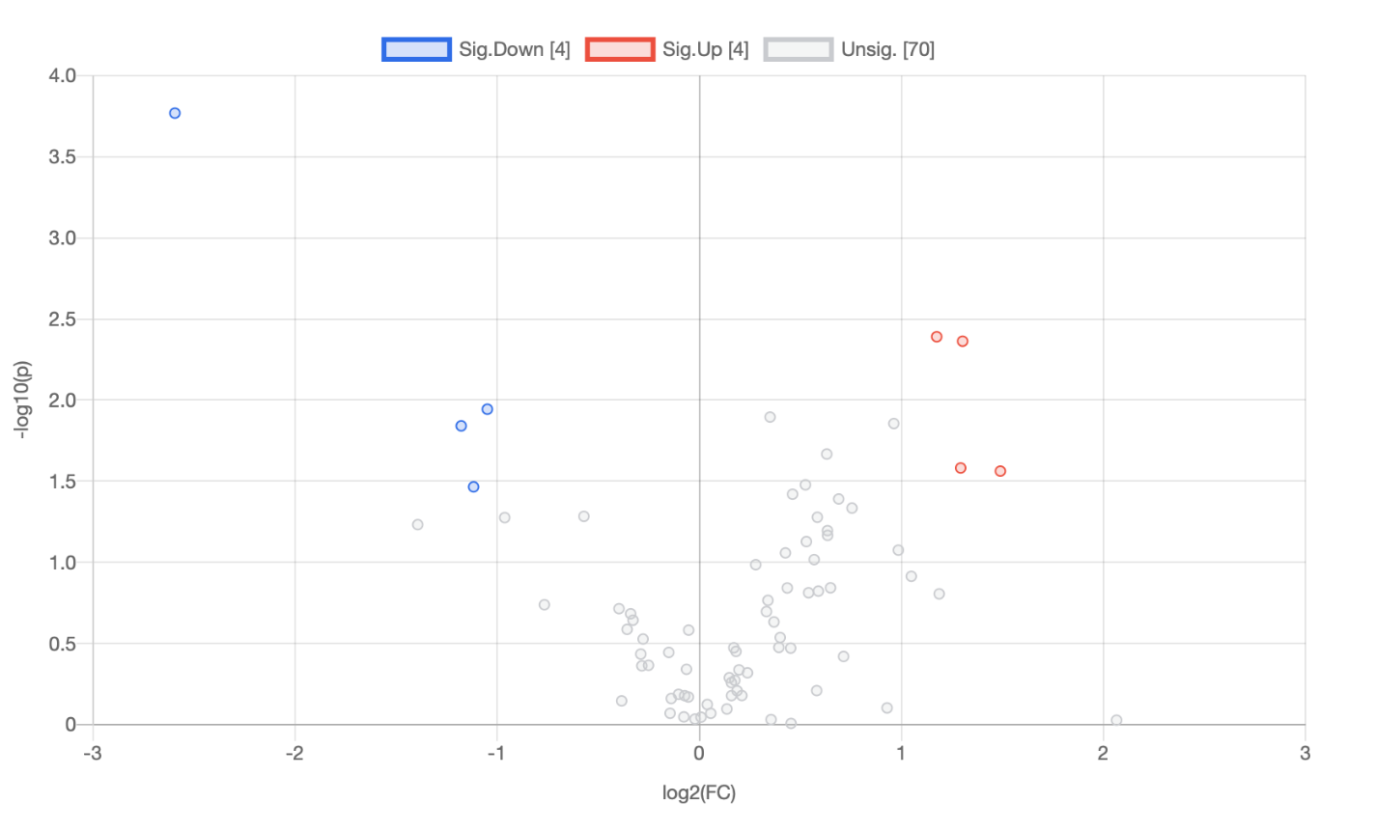
Comparison 1. Trisomy 21 vs Trisomy_AOAA only flux forms
In some cases, the peak quality affects more on p-value than actual flux. Good to make graphs from all in addition
to these that I´ve done

Slide 3
Heatmap – t-test
Glycerol 3-phosphate pathway down
Nucleotide synthesis down
NAD synthesis
TCA flux up in AOAA

Slide 4
t-test raw p-value <0.05
 | t.stat | p.value | -log10(p) | FDR
DHAP+3 | -5.0723 | 0.00017016 | 3.7691 | 0.013273
cis-aconitate +2 | 3.4293 | 0.0040686 | 2.3906 | 0.11273
cis-aconitate +4 | 3.3973 | 0.0043359 | 2.3629 | 0.11273
erythrose 4-phosphate+3 | -2.9116 | 0.011377 | 1.944 | 0.16071
Aspartate +2 | 2.855 | 0.012723 | 1.8954 | 0.16071
phosphoserine+3 | 2.8083 | 0.013951 | 1.8554 | 0.16071
Pyruvate +3 | -2.7914 | 0.014423 | 1.8409 | 0.16071
Malate +2 | 2.5869 | 0.021518 | 1.6672 | 0.2098
Glucose-6-phosphate +6 | 2.4852 | 0.026204 | 1.5816 | 0.21373
2HG+3 | 2.462 | 0.027402 | 1.5622 | 0.21373
citrate/isocitrate +3 | 2.3607 | 0.033279 | 1.4778 | 0.22269
UMP+5 | -2.3454 | 0.03426 | 1.4652 | 0.22269
citrate/isocitrate +2 | 2.2907 | 0.038015 | 1.42 | 0.22672
Malate +4 | 2.2547 | 0.040693 | 1.3905 | 0.22672
NAD +5 | 2.1856 | 0.046334 | 1.3341 | 0.22969
Glycerol 3-phosphate pathway down in AOAA?
DHAP down, but could be due to glycolysisi as well
- Glycerol 3 phosphate down as well in data!
TCA flux up in AOAA
Would be important again to see
AMP:ADP:ATP levels

Slide 5
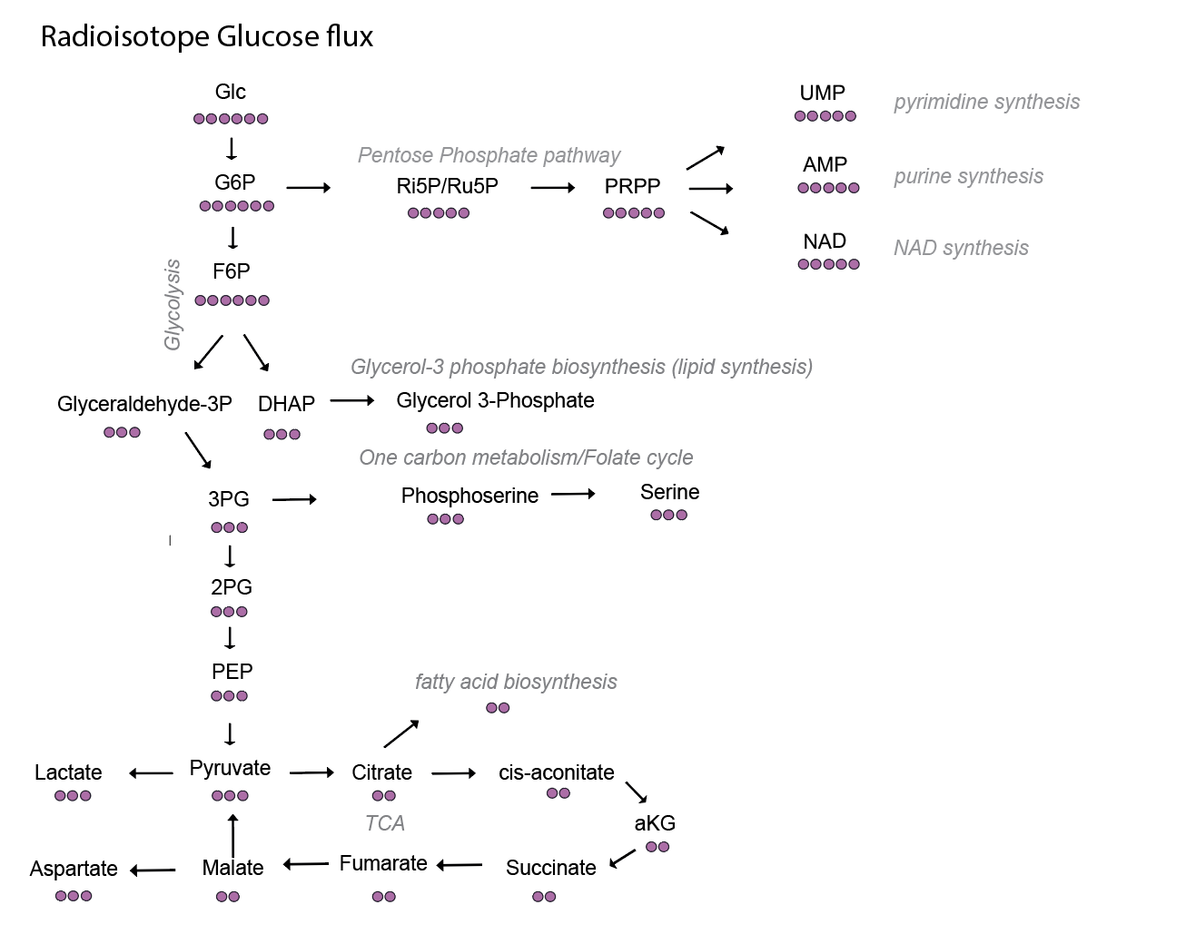
Glycolysis in Trisomy with AOAA: pyruvate down, but most likely pyruvate is imported to mitochondria faster
AOAA
Would be good if you make graphs for all of these in excell

Slide 6
PPP shunt: Pyrimidine decreased in Trisomy
AOAA
Too low values
?
Show also ATP+5 Not significant but same trend
Only pyrimidine affected

Slide 7
TCA: AOAA increased TCA flux in Trisomy!
AOAA

Slide 8
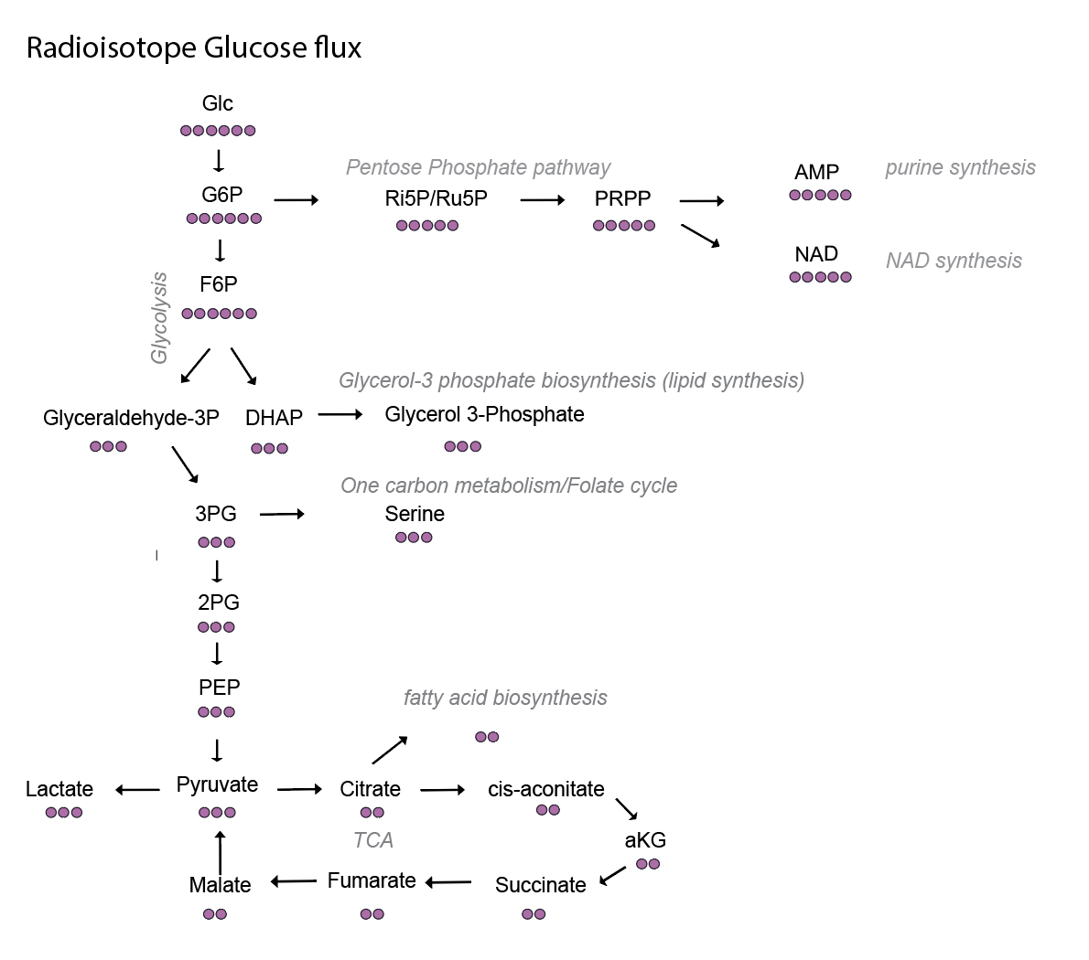
AOAA reverts Glycerol 3-phosphate synthesis increased in Trisomy (Triglycerides?)
AOAA
Show also Glycerol-3 phoshate
Not significant but same trend

